Slide 1




GAMING ZONE HUB USING CISCO PACKET TRACER

Slide 2

Team Members
M AFNAN
AM.EN.U4ECCE22023
M Y RAVI TEJA
AM.EN.U4ECCE22024
N VIVEKANANDA
AM.EN.U4ECCE22028
SAI VIRASITH M
AM.EN.U4ECCE22040
M VINEETH
AM.EN.U4ECCE22056

Slide 3
introduction
The Gaming Centre project simulates a real-time cyber café setup using Cisco Packet Tracer. It includes a structured network topology with multiple client PCs, administrative control, a central router, and internet access via a DSL modem. The project also integrates a billing website hosted online, accessible only from the admin system. This project enhances understanding of practical networking, IP planning, and access control implementation.

Slide 4

objective
The primary objective of this project is to design and simulate a reliable and scalable network for a gaming centre. The system aims to deliver high-speed internet access to users, manage bandwidth efficiently, and restrict administrative functionalities to authorized systems. It also seeks to integrate real-world web services into the network, bridging the gap between simulation and practical deployment.

Slide 5

system design
The network is divided into two main sections: the public user network and the admin network. Each section is connected to a central switch, which routes traffic through a router connected to the internet via a DSL modem and cloud. The admin system is configured to exclusively access the billing website hosted online. ACLs (Access Control Lists) are used to restrict access based on IP addresses. This ensures both security and operational control in a shared-use environment.

Slide 6


website integration
b.
A.
A unique aspect of the project is the integration of a functional website: https://gaming-centre.vercel.app/, which handles billing and login functionalities. This website is made accessible only through the admin system by implementing an outbound access list on the router. The ACL allows web access for the admin IP address while denying it for all others. This mimics real-world cyber cafes where only authorized systems are used for billing or account management.

Slide 7

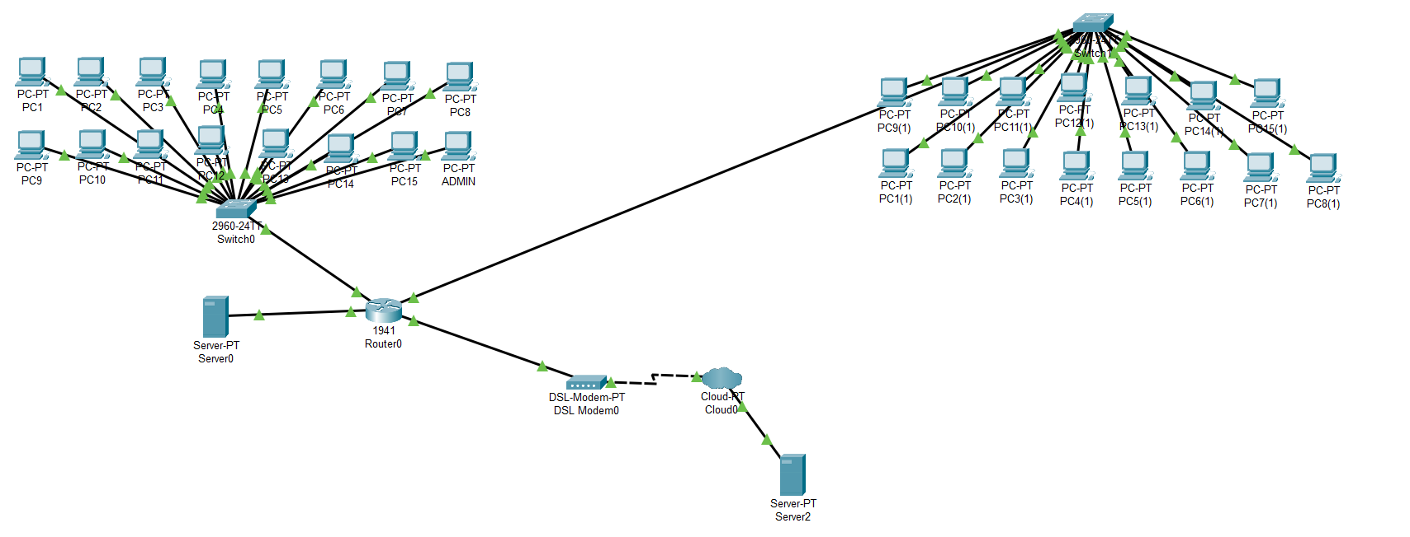

circuit diagram

Slide 8
The simulated network successfully connects 30+ systems across two switches with seamless connectivity to the internet. The ACL applied to the router interface verified that only the admin system could access the billing site. All other client systems had normal internet access for gaming and browsing, but no access to the billing portal, confirming the access control setup worked as intended.
Results

Slide 9
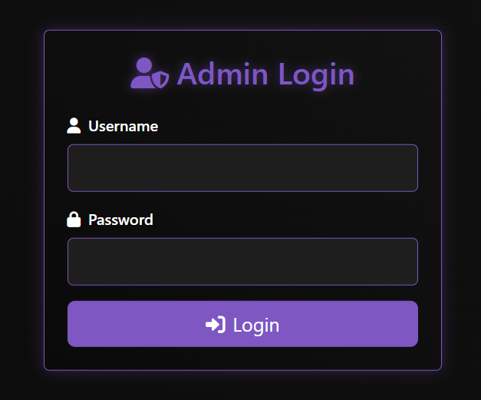
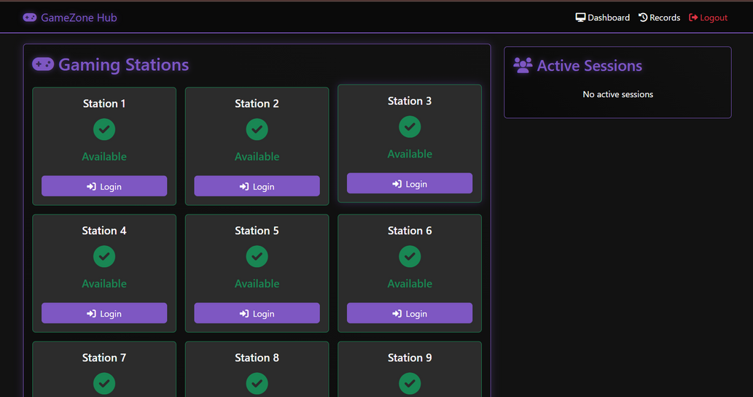
Admin page
dashboard page

Slide 10
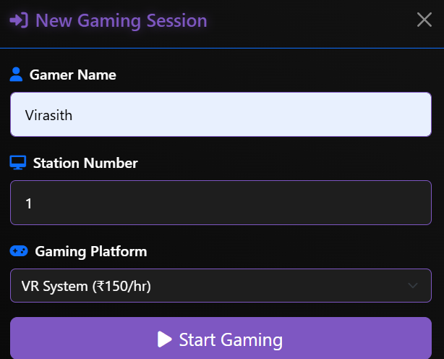
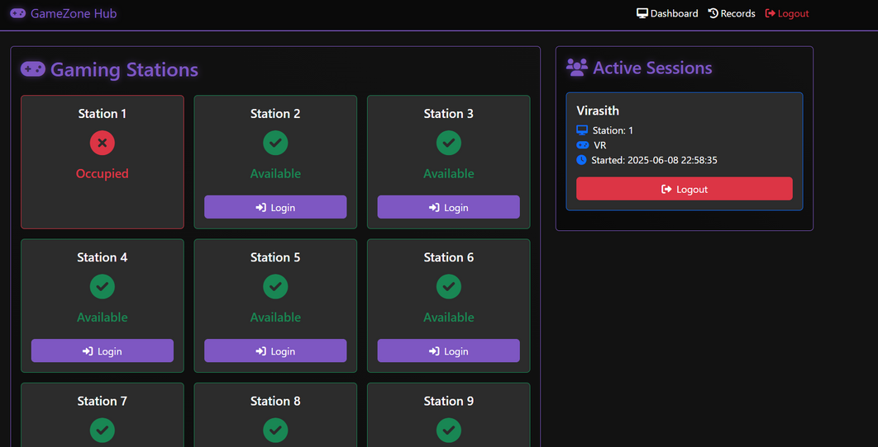
user session login
When a user is using System-1

Slide 11
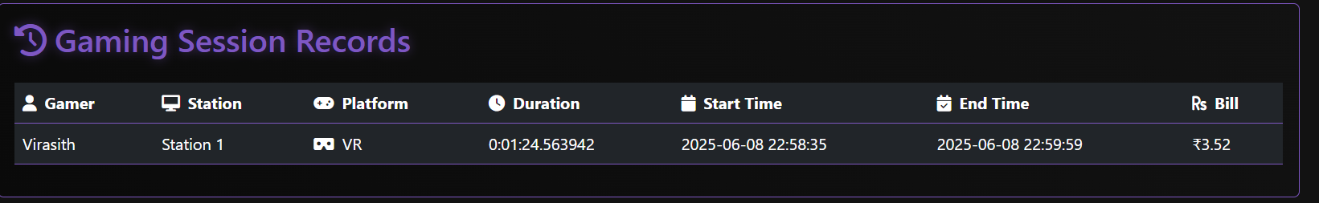
After completion the session by user we can logout and when we will click on logout we can get the bill by going to records

Slide 12
THANK YOU

